Slide 1






ASP.NET User Controls
Creating and Using .ASCX User Controls
.ASCX
ASP.NET Web Forms
Telerik Software Academy
http://academy.telerik.com

Slide 2
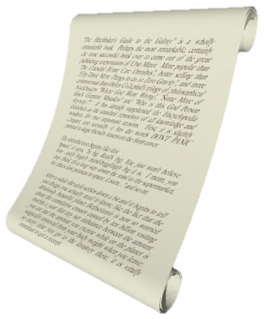

Table of Contents
Creating and Using Web User Controls
Creating and Using Web Custom Controls
Case Study: Creating an Info / Error / Success Notification User Control

Slide 3
ASP.NET User Controls and Custom Controls
ASP.NET offers two ways of building reusable UI components:
Web User Controls
UI server controls (reusable code snippets), designed in Visual Studio
Consist of .ascx and .ascx.cs files, inherit from UserControl
Web Custom Controls
Plain C# code inheriting from WebControl
No HTML, rendered in C# code

Slide 4

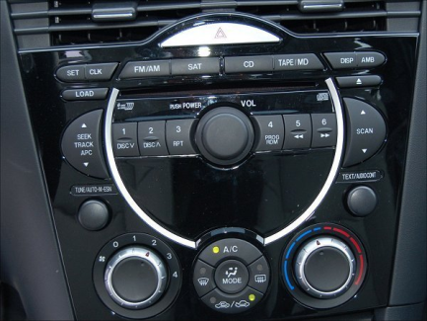


ASP.NET User Controls

Slide 5
User Controls
Web user controls are reusable UI components used in ASP.NET Web Forms applications
User controls derive from UserControl which derive from TemplateControl
Similar to a Web form
Have HTML code and C# code (code behind)
Could have properties and events
Allow developers to create their own controls with own UI and custom behavior

Slide 6
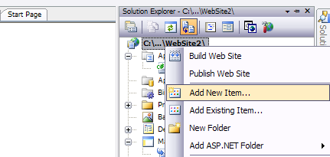
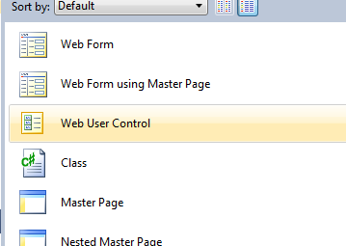
User Controls (2)
Adding a Web User Control from Visual Studio:

Slide 7
User Controls (3)
A Web user control is:
An reusable ASP.NET code snippet that can be nested as part of an ASP.NET page
A server component which offers a user interface and attached logic
Server side logic and lifecycle events (C# code behind)
Client-side logic (JavaScript code)
Shared between the pages of the application
Cannot be displayed directly in the browser

Slide 8
User Controls (4)
Differs from custom server controls
Custom controls are advanced and beyond the scope of the course
Consists of HTML and code
Doesn’t contain <head>, <body> and <form> HTML tags
Uses @Control instead of @Page

Slide 9
User Controls – Advantages
Independent
Use separate namespaces for the variables
Avoid name collisions with the names of methods and properties of the page
Reusable
User controls can be used more than once on a single page
No conflicts with properties and methods
Language neutrality
User controls can be written in a language different of the one used in the page

Slide 10
Sharing of User Controls
User controls can be used throughout an application
Cannot be shared between two Web applications
Except by the copy&paste "approach" ☺
Another approach is to create a Web custom control
Everything is manually written
Notes:
Бележки на автора:
Споделяне на потребителски контроли
Потребителските контроли могат да се споделят между всички страници на уеб приложението. Не могат да се споделят между различни уеб приложения (като изключим copy&paste "технологията" ☺ ).
Друг подход е да се създаде Web custom контрола. Създаването на такава е много по-трудоемко, защото за разлика от потребителските контроли всичко се пише на ръка.

Slide 11
Using User Controls
A user control can be added to each ASP.NET Web form
The form is called "host"
The form adds the control by using the @Register directive
TagName defines the name used by tags that will insert an instance of the control
Src is the path to the user control
<%@ Register TagPrefix="demo" TagName="SomeName"
Src="NumberBox.ascx"%>

Slide 12
Example: Welcome Label
We want to create a "Welcome Label" user control
Like the <asp:Label> control
Has Name and says "Welcome, Name"
Has Color and AlternateColor (on mouse over)
WelcomeLabel.ascx
<%@ Control Language="C#" AutoEventWireup="true"
CodeBehind="WelcomeLabel.ascx.cs"
Inherits="Custom_Controls_Demo.WelcomeLabel" %>
<asp:Label ID="LabelWelcome" runat="server" />
WelcomeLabel.ascx.cs
public partial class WelcomeLabel : System.Web.UI.UserControl
{
…
}

Slide 13
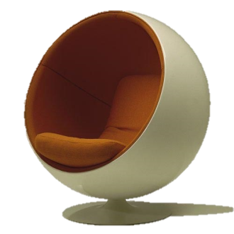
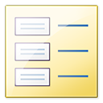
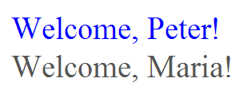
Welcome Label ASCX
Live Demo

Slide 14
Example: Numeric Box
We want to create a "Numeric" user control
Like the <asp:TextBox> control
For integer numbers only
With "+" and "-" buttons
NumericBox.ascx
<%@ Control Language="C#" CodeBehind="NumericBox.ascx.cs" … %>
<asp:TextBox ID="TextBoxNumber" runat="server" … />
<asp:Button ID="ButtonIncrease" runat="server" Text="+" … />
<asp:Button ID="ButtonDecrease" runat="server" Text="-" … />
NumericBox.ascx.cs
public partial class NumericBox : System.Web.UI.UserControl
{
…
}

Slide 15


Numeric Box
Live Demo

Slide 16
ASP.NET Custom Controls

Slide 17
ASP.NET Custom Controls
Web custom controls
Plain C# code inheriting from WebControl
No HTML, rendered in C# code
Attributes [Category("…")] and [Description("…")] serve for interaction with the Visual Studio's Property Designer
The RenderContents method renders the control as HTML code

Slide 18

ASP.NET Custom Control: SEOPlugin
Live Demo

Slide 19
Creating an Error / Success Notification User Control
Create a user control for displaying message boxes: ErrorSuccessNotifier.ascx
Keep all its assets (HTML code, C# code, images, styles and client-side scripts) in its own directory: /Controls/ErrorSuccessNotifier/
Keep a list of messages in the Session object
Message types: Success, Info, Warning, Error
Render the messages dynamically as panels
Include the CSS and client-side scripts on demand through the ClientScriptManager

Slide 20
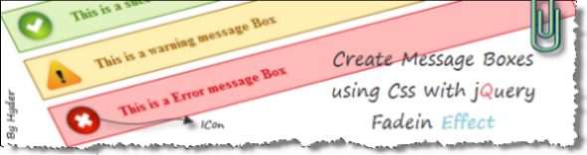
Creating an Error / Success Notification User Control
Live Demo

Slide 21
ASP.NET User Controls
http://academy.telerik.com

Slide 22
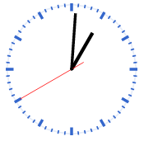
Exercises
Create a user control that visualizes a menu of links. The control should have a property to initialize the menu links (a list of items, each containing a title and URL). Use DataList and data binding to visualize the menu links. Implement a property to change the font and the font color. Don’t use the Menu control!
* Create a custom control to display an analog clock based on the HTML 5 canvas (you could take some code from http://randomibis.com/coolclock/). Define a property to change the time zone. All control assets (CSS, images, scripts, etc.) should be loaded dynamically at runtime when the control is rendered.

Slide 23



Free Trainings @ Telerik Academy
"Web Design with HTML 5, CSS 3 and JavaScript" course @ Telerik Academy
html5course.telerik.com
Telerik Software Academy
academy.telerik.com
Telerik Academy @ Facebook
facebook.com/TelerikAcademy
Telerik Software Academy Forums
forums.academy.telerik.com

